Slide 1
JUnit4 and Mockito Help: http://www.baeldung.com/mockito-spy

Slide 2
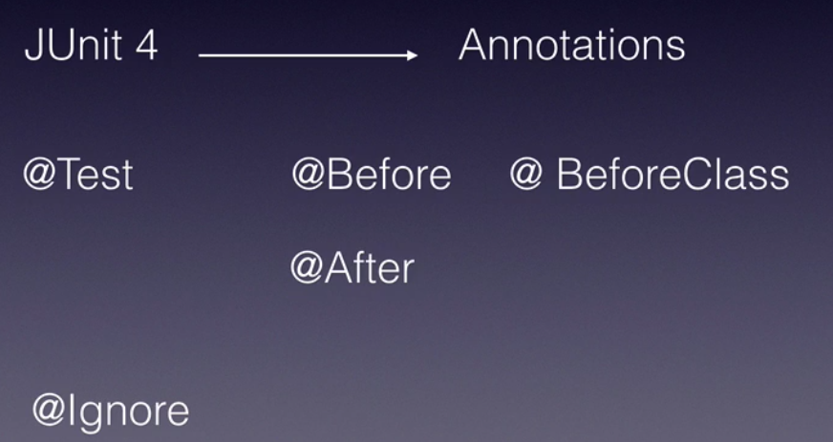
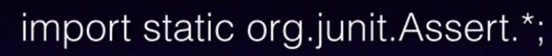
@Test -> Use each and every test method
@Before -> Use to mark setup method to create all the object before returning @Test and all the data we setup for particular test. It will run each test method.
@After -> It will run after every test method. We do all cleanup.
@BeforeClass -> Will be run for the entire test class at the beganining.
@Ignore -> Test will be ignore. (also from maven and ant)
assertNotNull -> will take an object if that object is null, assertion will fail
assertEquals-> Checks for the value of two objects.
assertSame-> Checks the reference of the two object.
We can run BlockJunit4ClassRunner from command line and pass our test class as a argument. This class will scan through our class for the annotation, like test and before annotation and it will report out all the test passed or failed. IDE/ANT/Maven internally uses this class.
@RunWith(SpringJUnit4ClassRunner.class extends BlockJunit4ClassRunner.class and it implements Junit runner framework for writing integration test, while working with Spring based application.

Slide 3
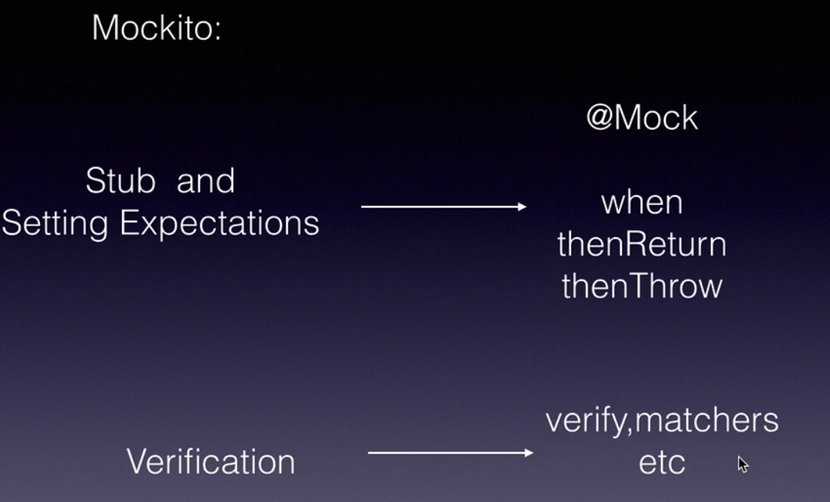
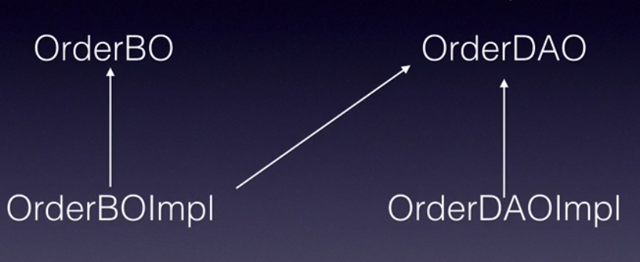
All the test cases should be void
When A depends on B, A & B should be test separately since it is unit testing
When we mock there are 3 steps 1. Stub 2. Setting Expectation and 3) verification

Slide 4
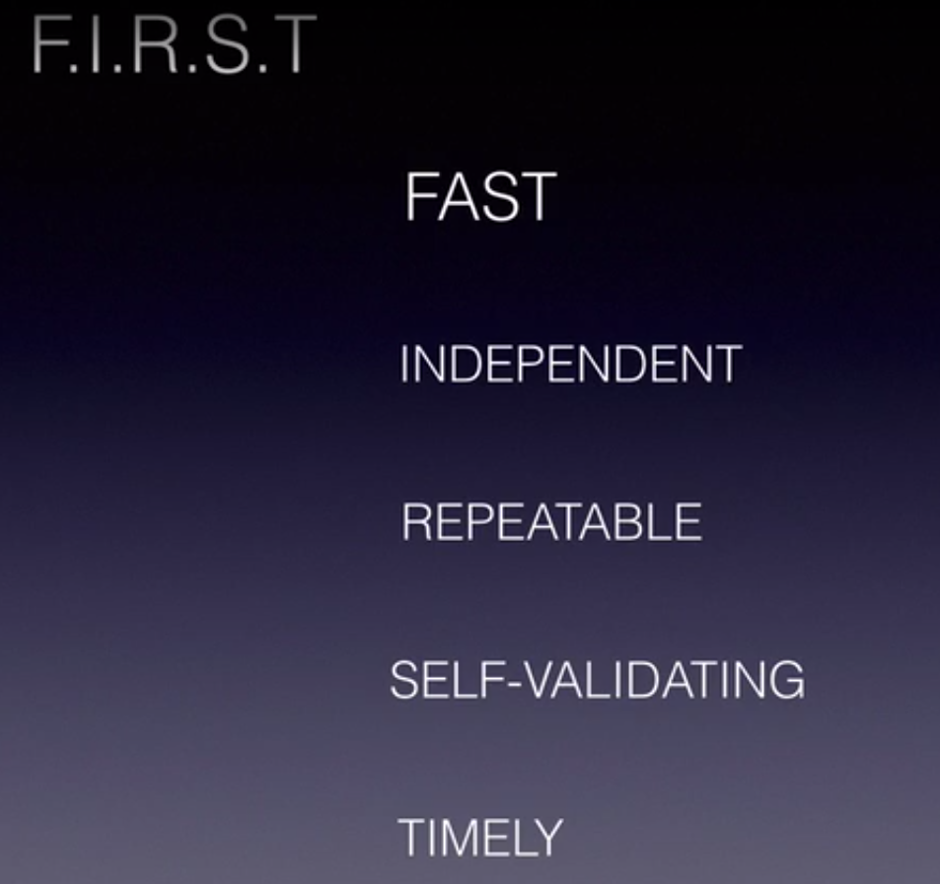
FIRST principle of Agile Software Testing
Fast -> Test should run first
Independent -> Test should not dependent on each other
Repeatable-> Test should run all environments like test, UAT and PORD.
Self-Validating->Test should Boolean result either fail or success
Timely -> We should write code in timely manner, on time even before writing any code.
Test Doubles : Gerard Meszaros come with this pattern when. There are 5 different patterns of Test Doubles, 1. Dummy, 2. Stubs, 3. Mocks, 4. Fake, 5. Spies
4. Fake -> In-memory databases for unit testing (Rarely used)
5. Spies-> There are spy to investigate any side effect when add new code.

Slide 5
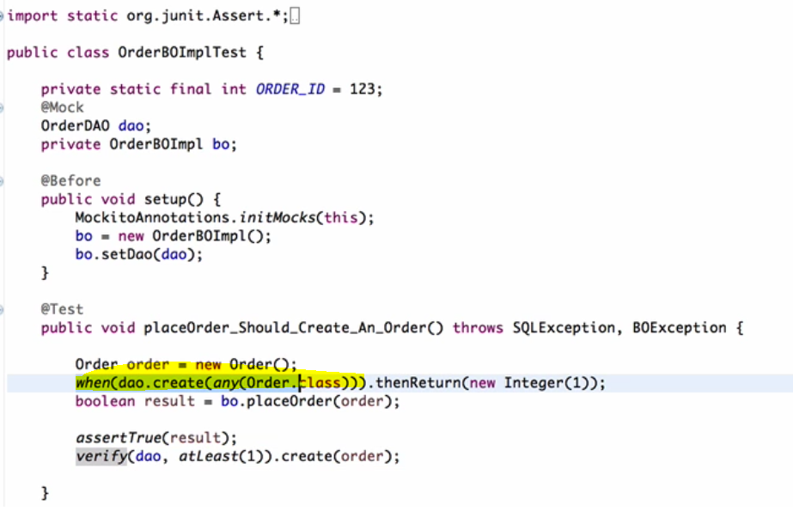

Slide 6
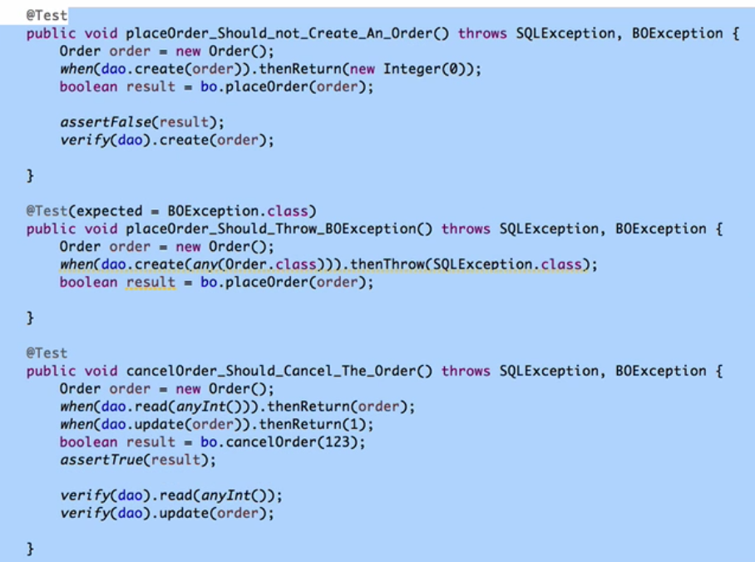

Slide 7
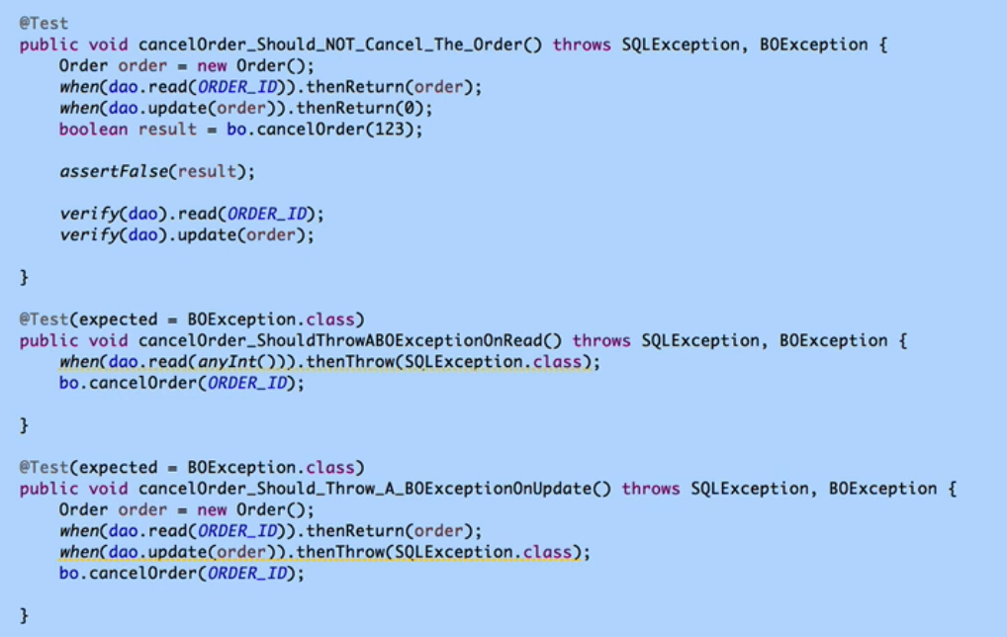

Slide 8
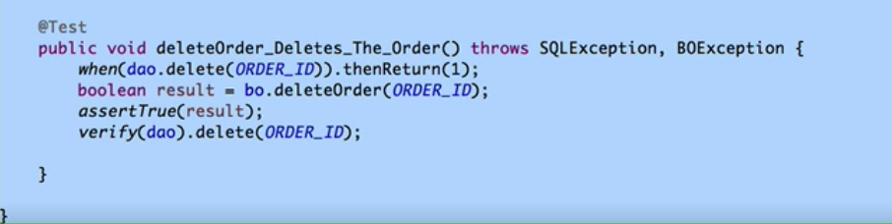
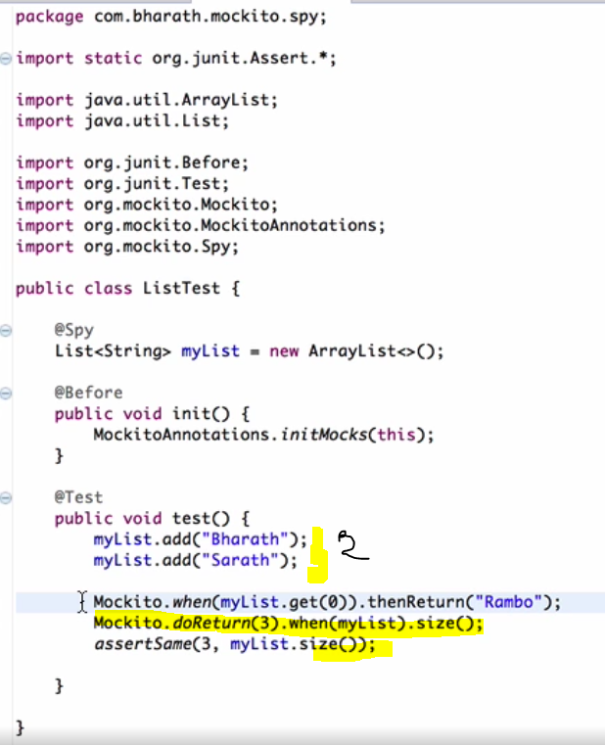
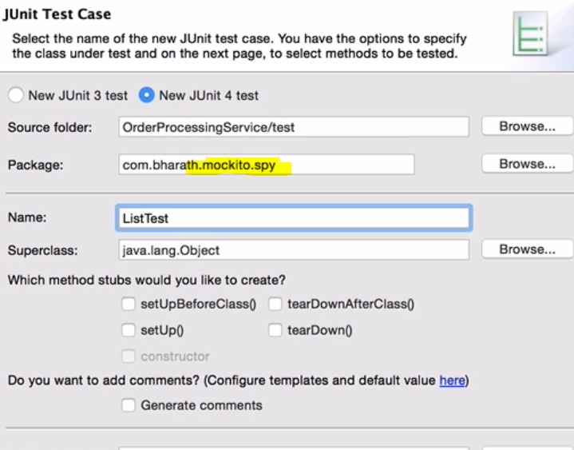
Spy

Slide 9
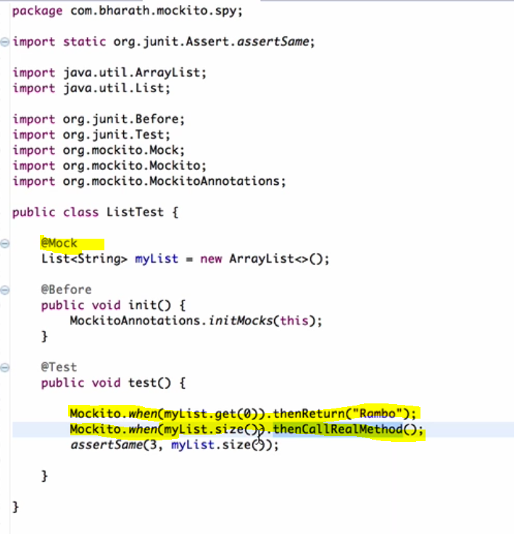
Mock (Better than Spy)

Slide 10
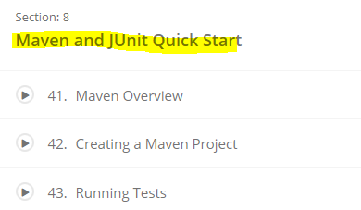
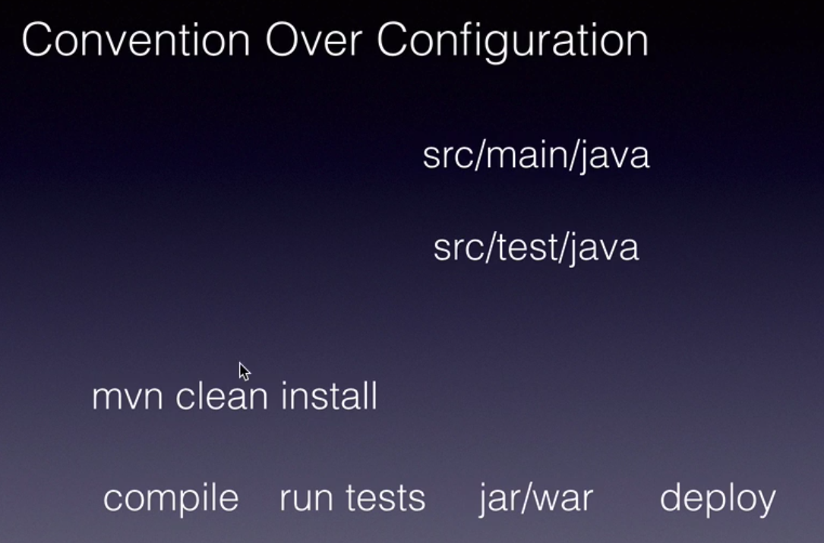
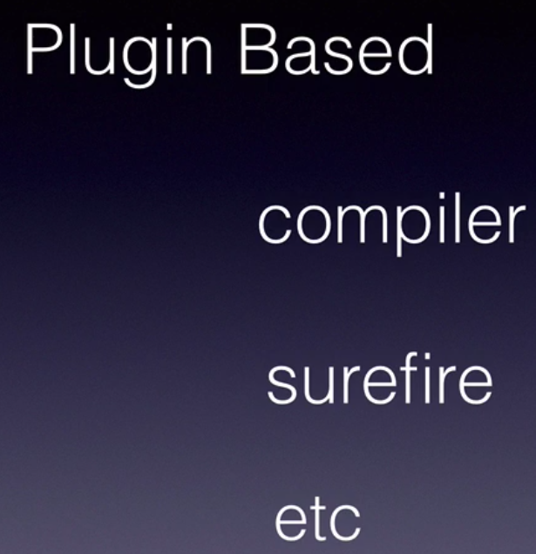
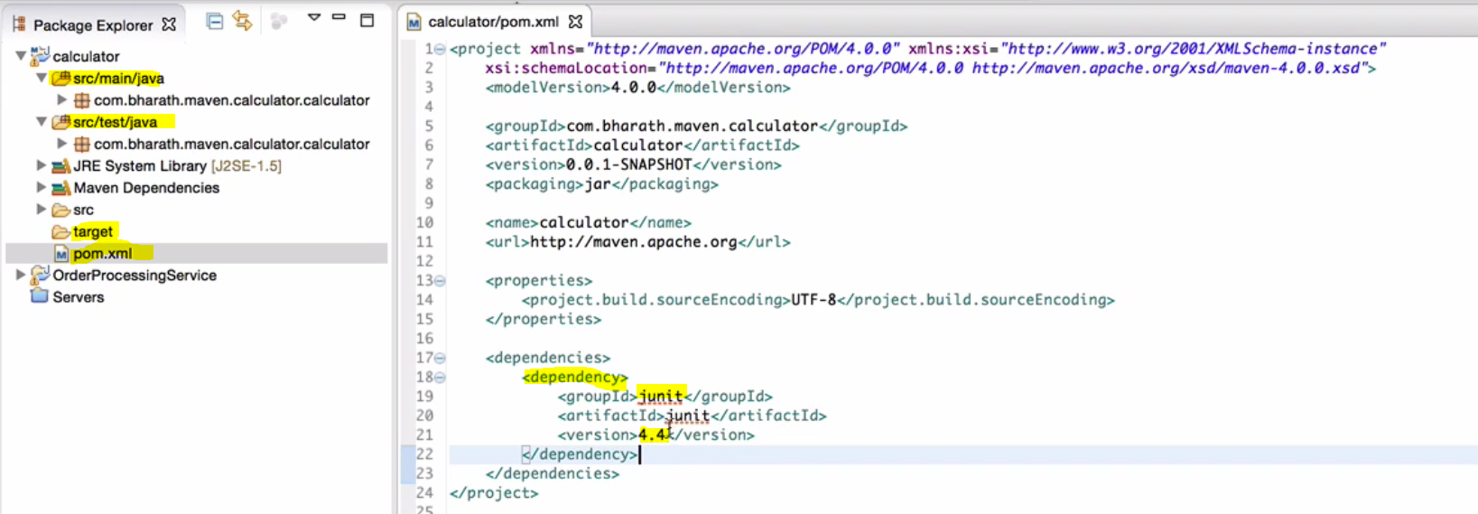


Slide 11
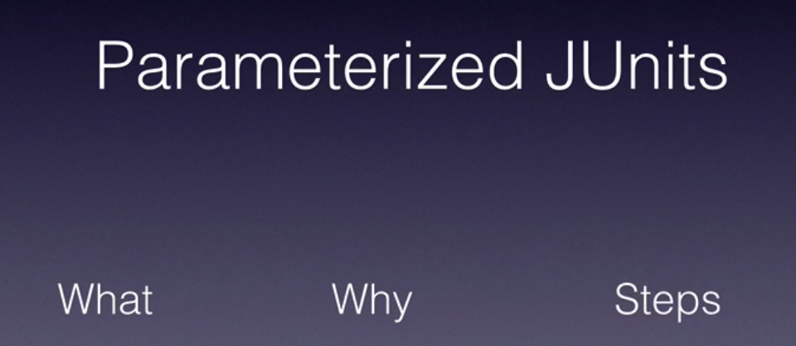
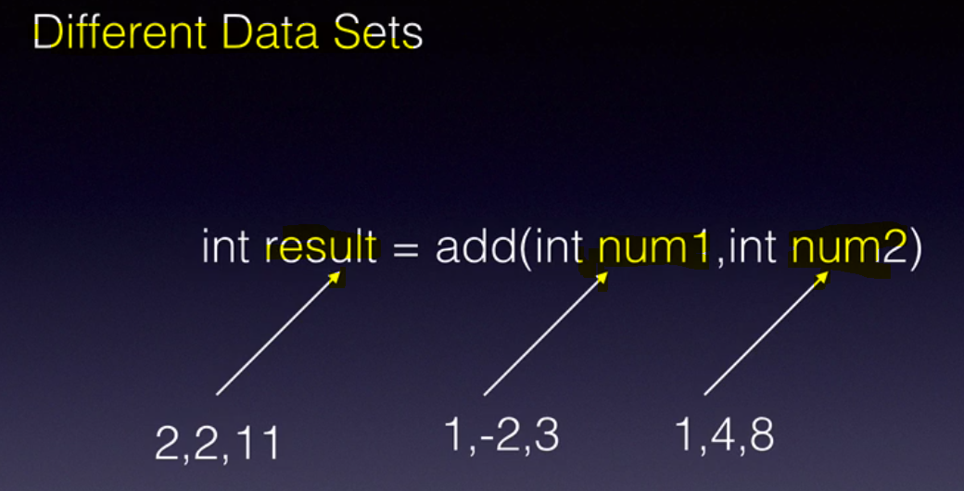
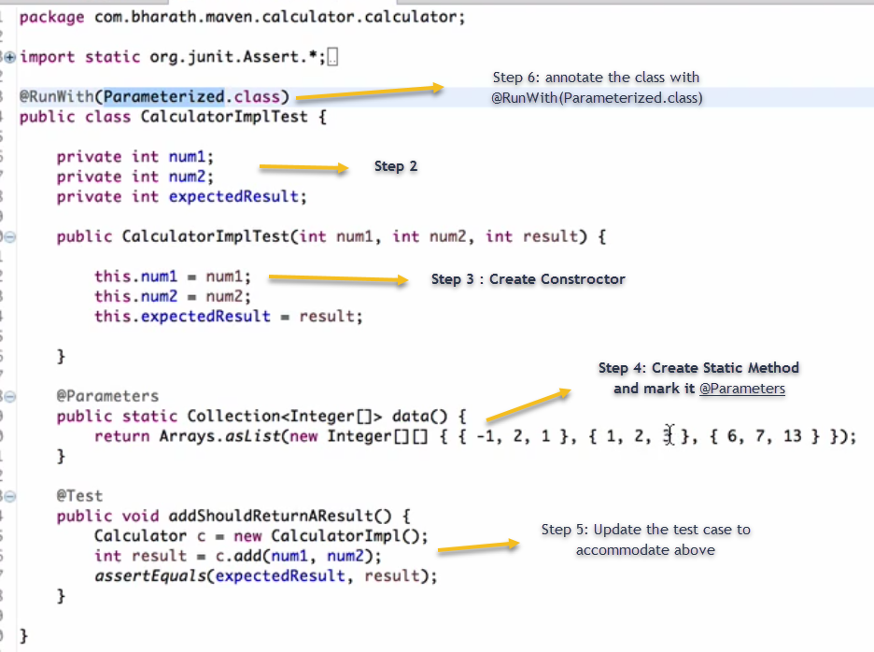
Introduced in Junit4 and parameter allows as to pass different types of data set in a single Junit test. Instead of writing multiple test, we can write one test using parameter like below:
Steps:
Identify the input data and result that can be passed.
Create global fields in the test class
Create a constructor
Create a Static method @ Parameters (this method will be marked)
Create or Update the test method
Mark the test with @RunWith(Parameterized.class)

Slide 12
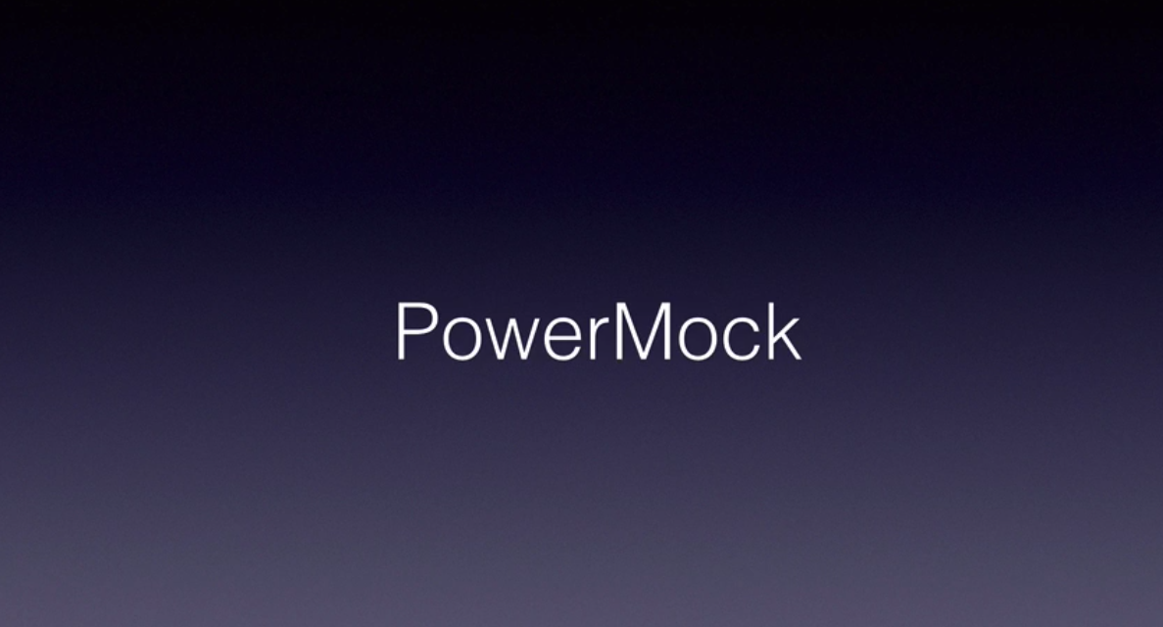

Slide 13
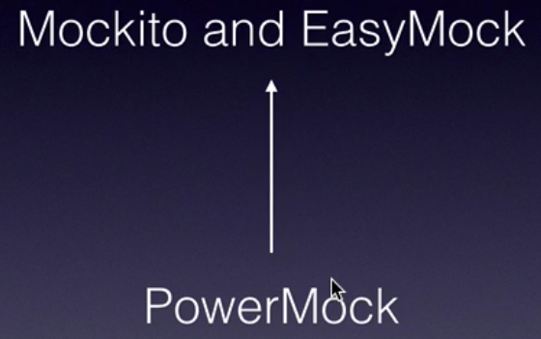
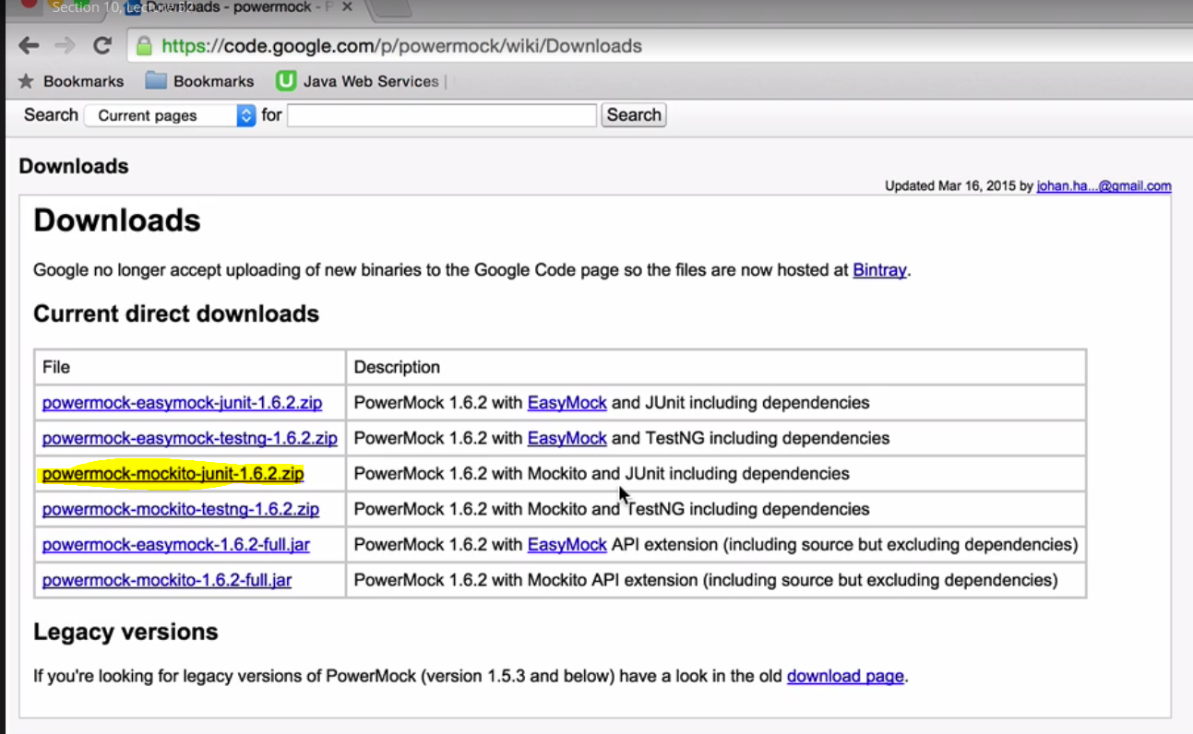
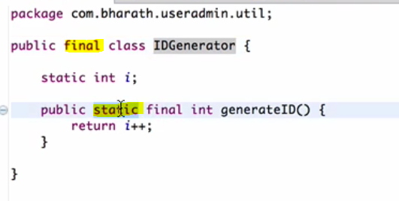
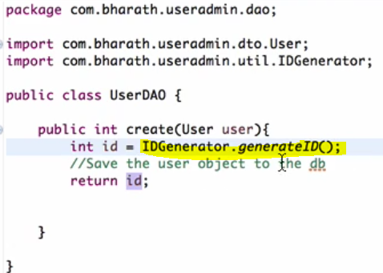
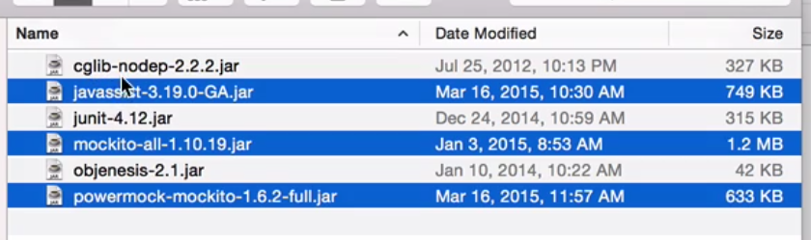
PowerMock overcomes Mockito Limitations. For example Static, Final, Constructors, Private and Enums are not testable. PowerMock provides that facilities. It extends Mockito and EasyMock (another mock framework) . Power mock uses Proxy Pattern. It uses Bytecode Manipulation and Custom Class Loader to achieve this.
Copy these 3 jars

Slide 14
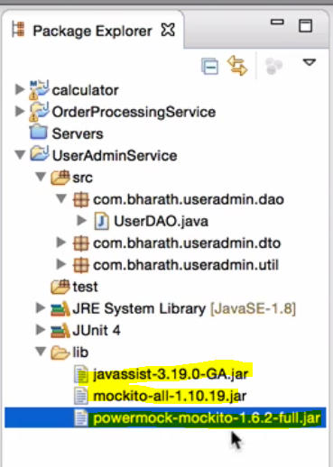
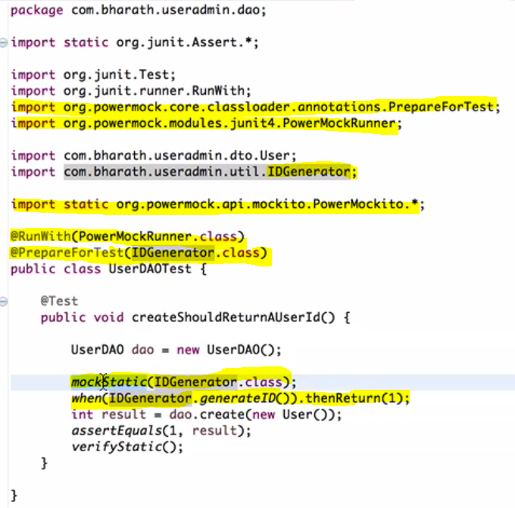

Slide 15
Spring

Slide 16
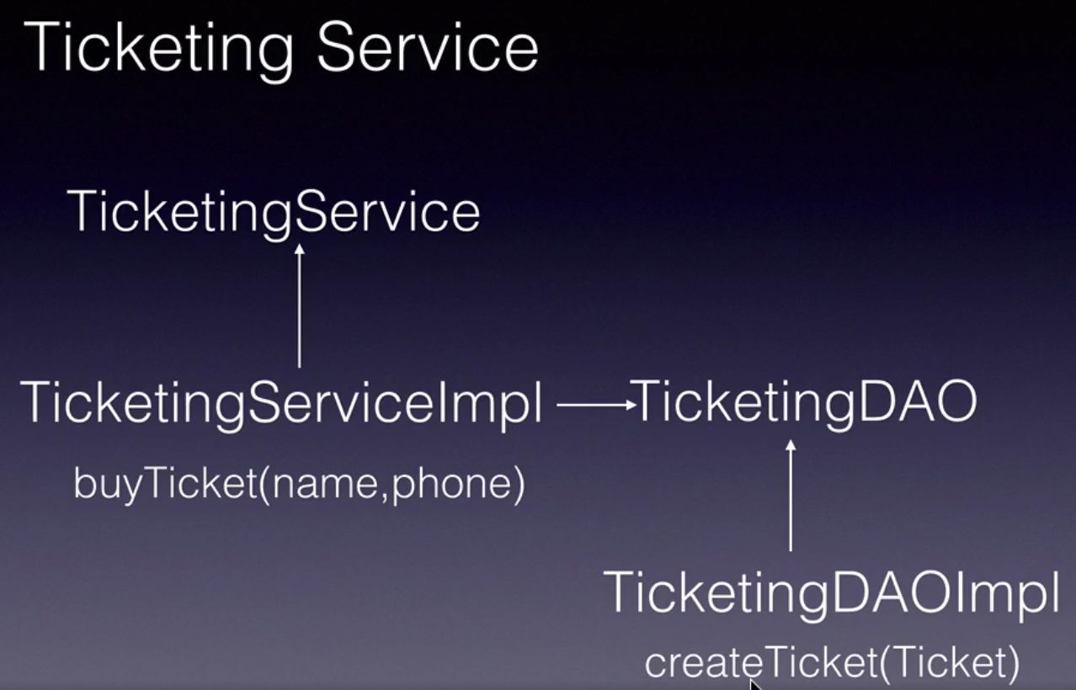
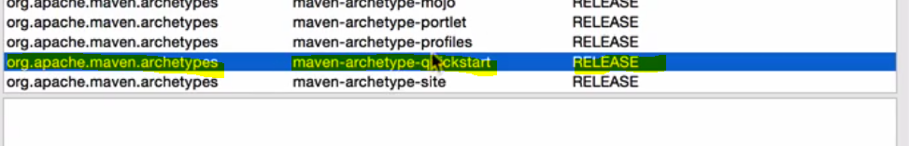
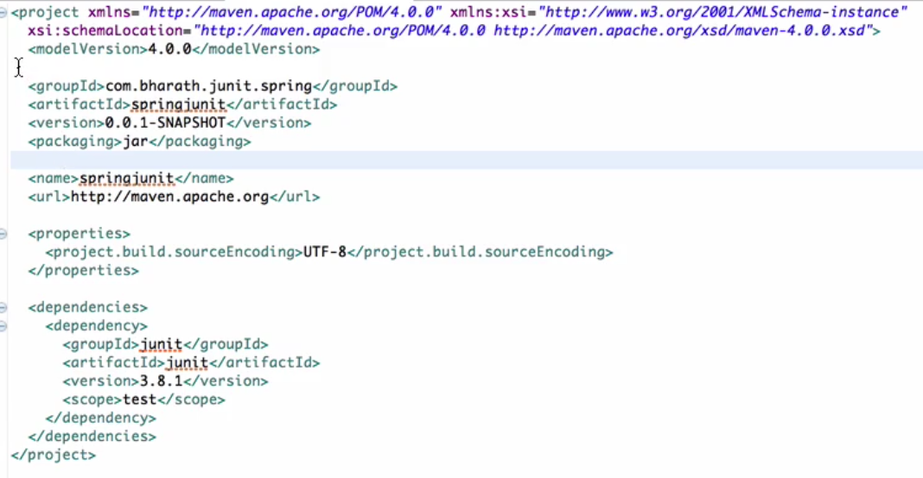
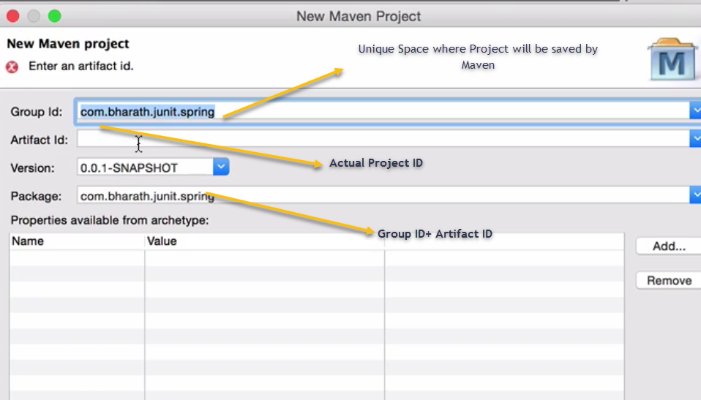
From Eclipse
Select Maven Project
Select maven-archetype-quickstat

Slide 17
